Slide 1
The Polarization of Information
Charles Dickens
Professor Narayana Prasad Santhanam
Dept. of Electrical Engineering, University of Hawaii at Manoa

Slide 2
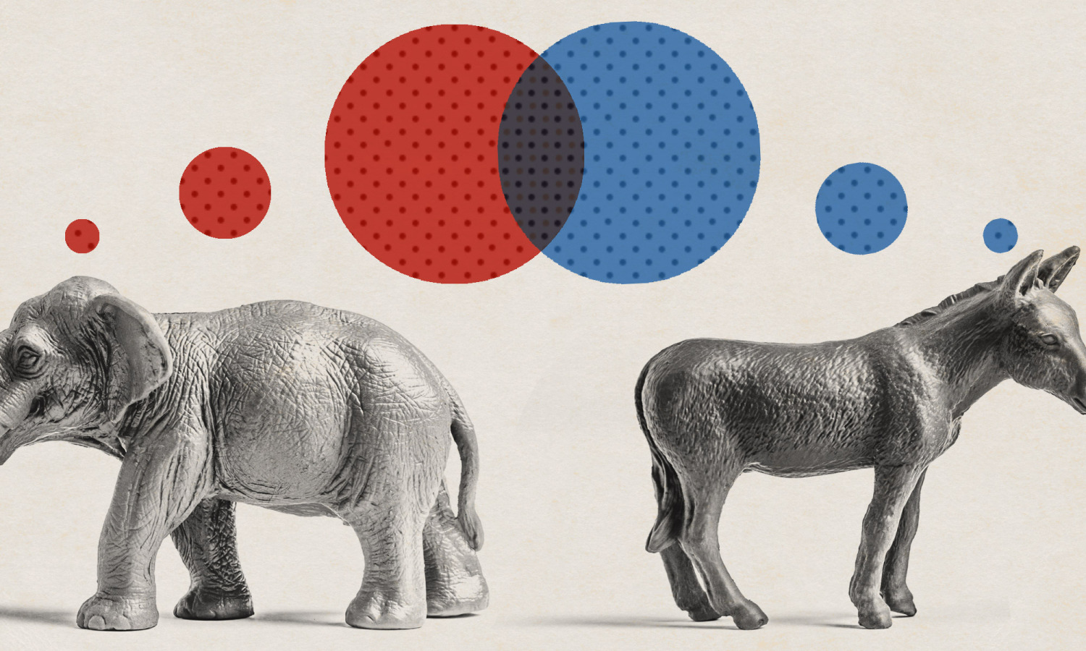
Introduction and Motivation
Many would agree that the United states political climate is becoming increasingly polarized
How could we quantify this troubling intuition?
TED (2016)
Is left vs. right enough to capture what is truly happening on the web?
How does polarization vary across topics?
Notes:
TED (2016). Political Polarization Illustration. [image] Available at: https://tedideas.files.wordpress.com/2016/11/featured_art.jpg?w=750 [Accessed 4 Dec. 2018].

Slide 3

Project Description
The primary focus of this project is to develop a system that can provide objective measurements of the polarity of the network of information and opinions on the popular microblog, Twitter.
The contributions of this report is the framework for a workflow which:
Models a network of tweets related to a common topic using a semi-supervised approach
Finds community structure in the model
Measures the polarity of the network using graph conductance
Wired (2018)

Slide 4
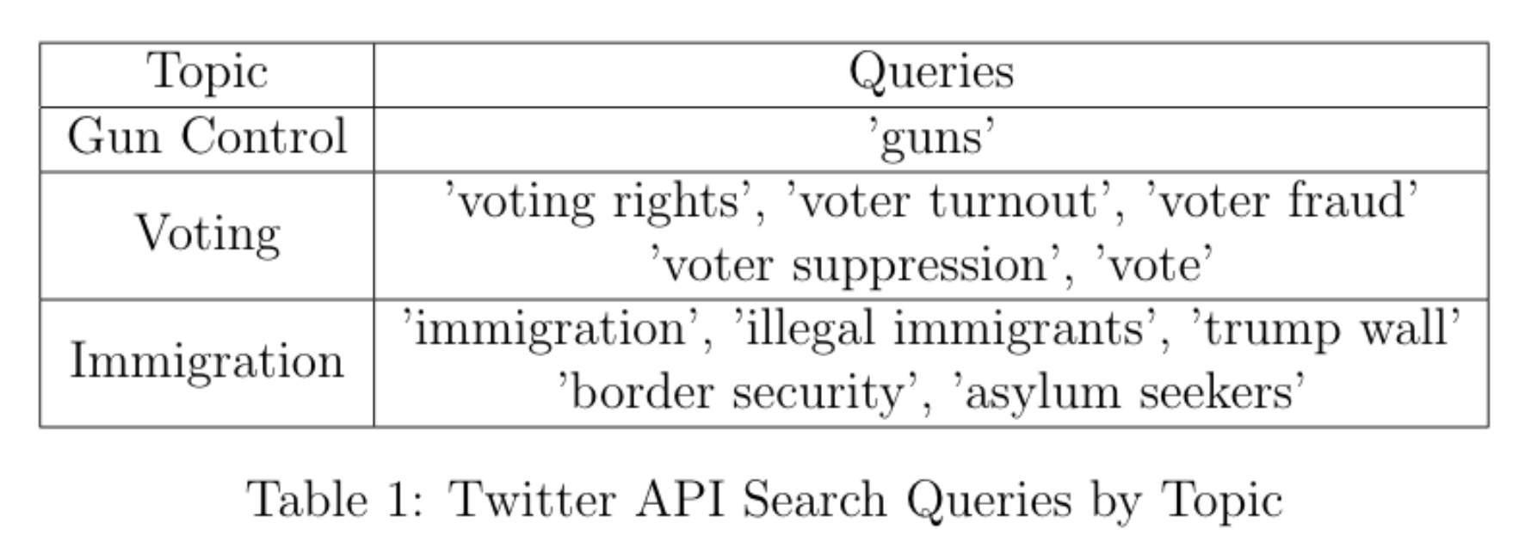
Methods
Retrieving Relevant Information and Opinions:
Twitter granted this project access the premium search API sandbox, which allows for 25000 tweets to be collected each month.

Slide 5
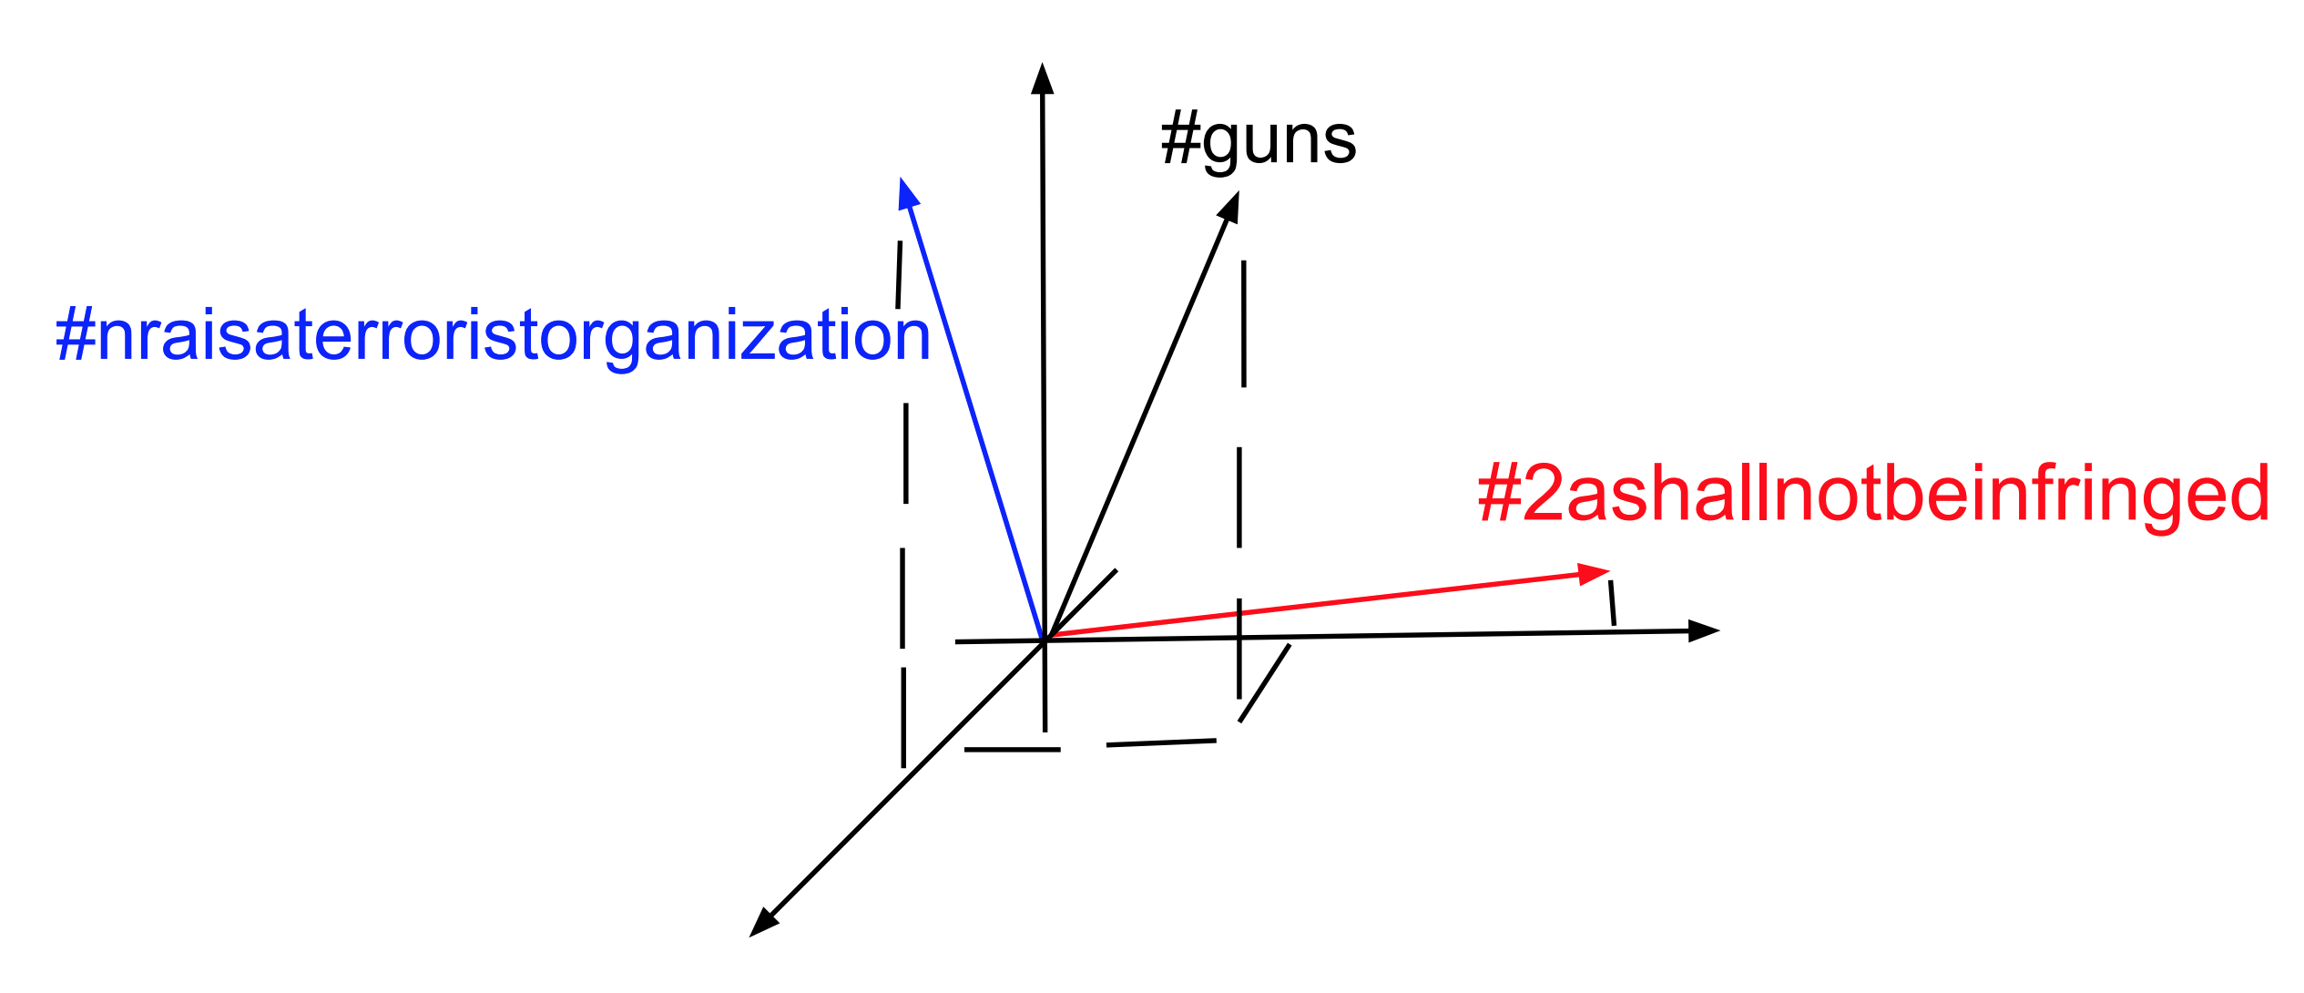
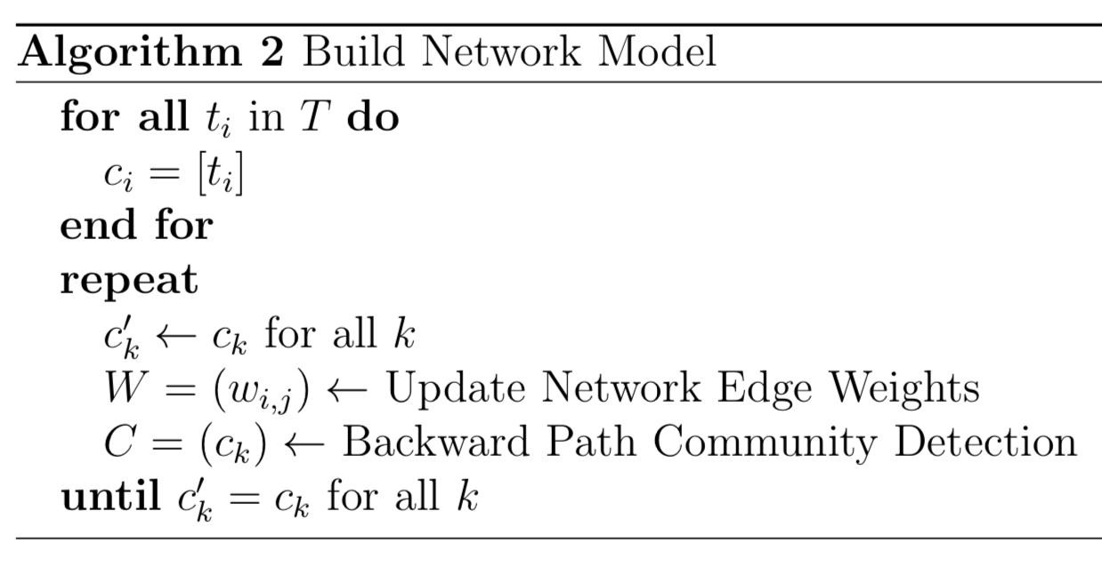
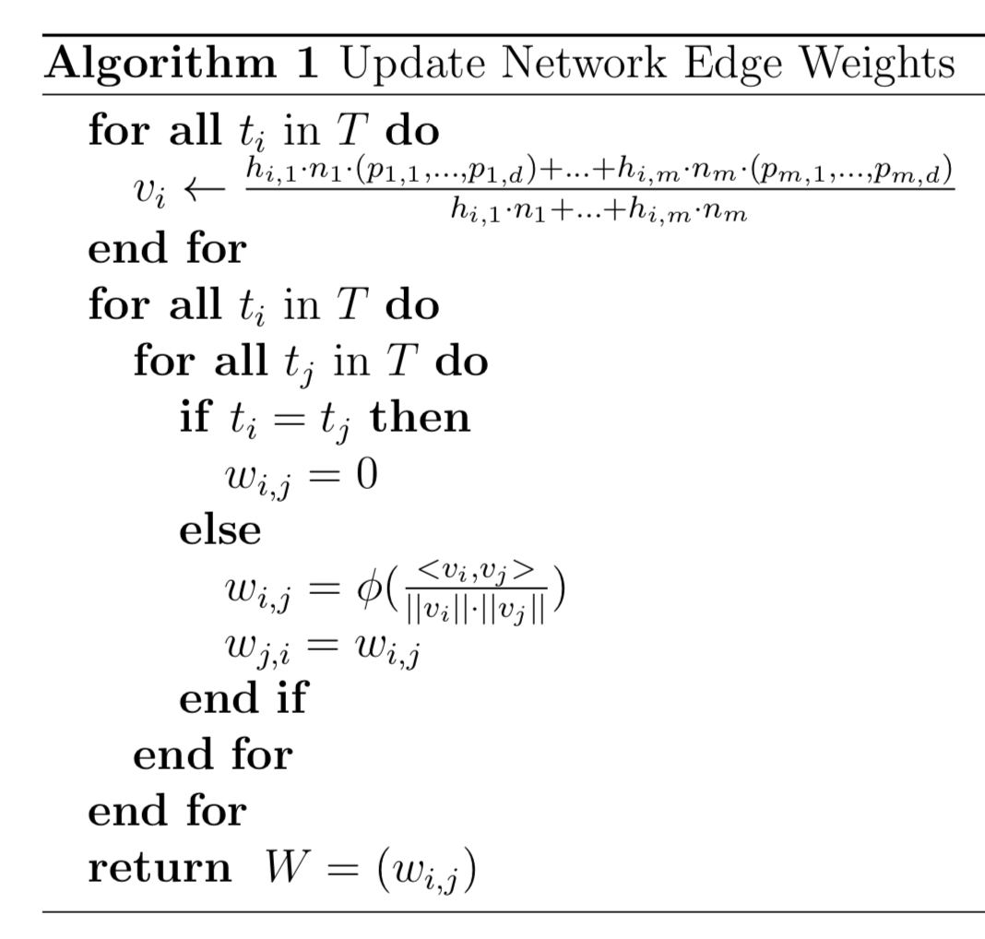
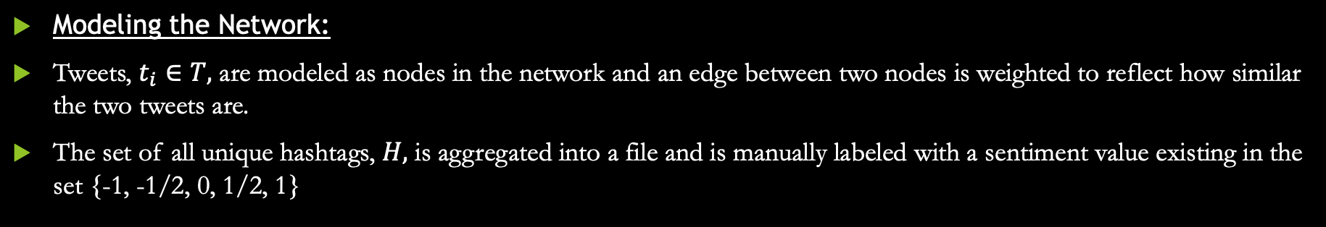
Methods
Modeling the Network:
Tweets, $t_{i}∈T,$ are modeled as nodes in the network and an edge between two nodes is weighted to reflect how similar the two tweets are.
The set of all unique hashtags, $H,$ is aggregated into a file and is manually labeled with a sentiment value existing in the set {-1, -1/2, 0, 1/2, 1}

Slide 6
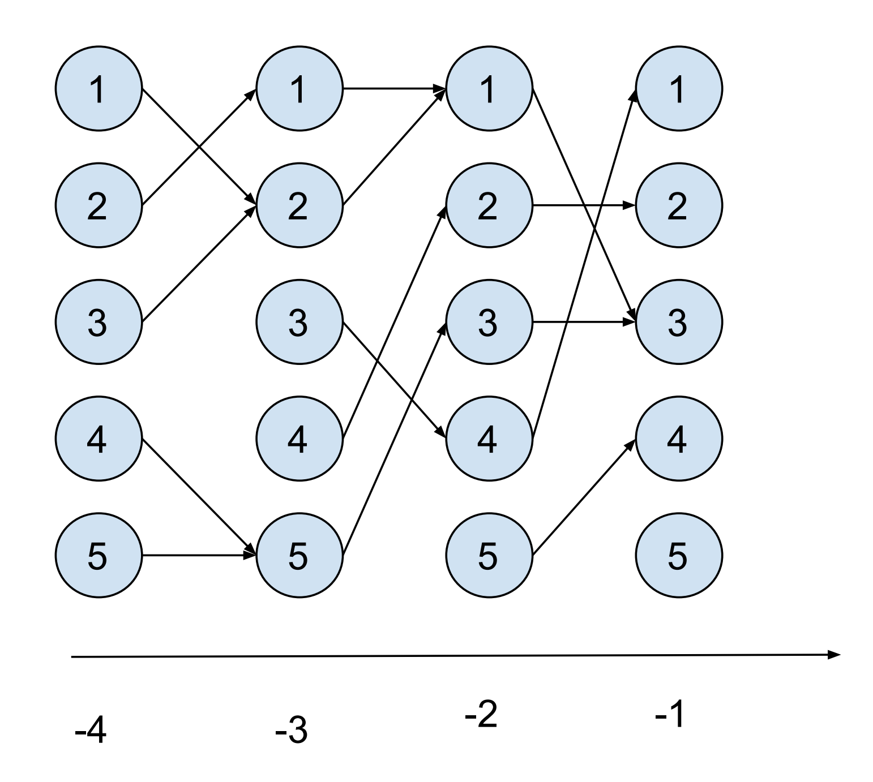
Methods
Community Detection:
The community detection algorithm used in the system, backward path community detection, was developed at the University of Hawai'i Big Data Lab (Paravi and Santhanam, 2015)

Slide 7
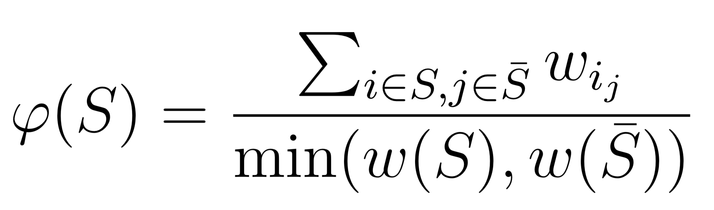
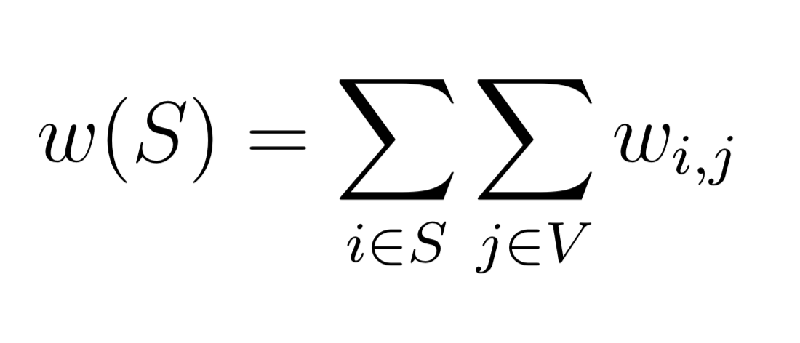
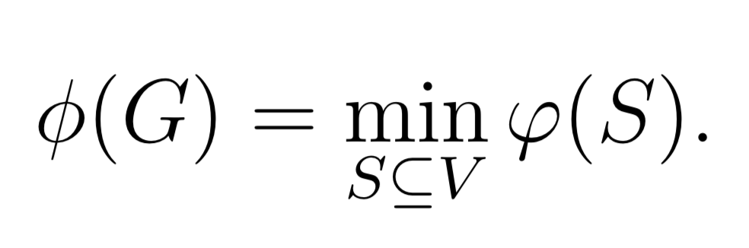
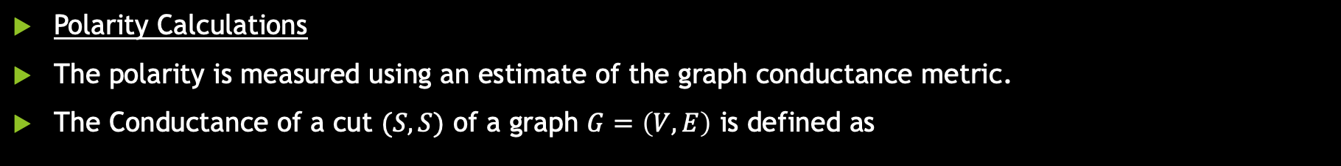
Methods
Polarity Calculations
The polarity is measured using an estimate of the graph conductance metric.
The Conductance of a cut $(S,S)$ of a graph $G=\left(V,E\right)$ is defined as
where
Then the graph conductance is defined as

Slide 8
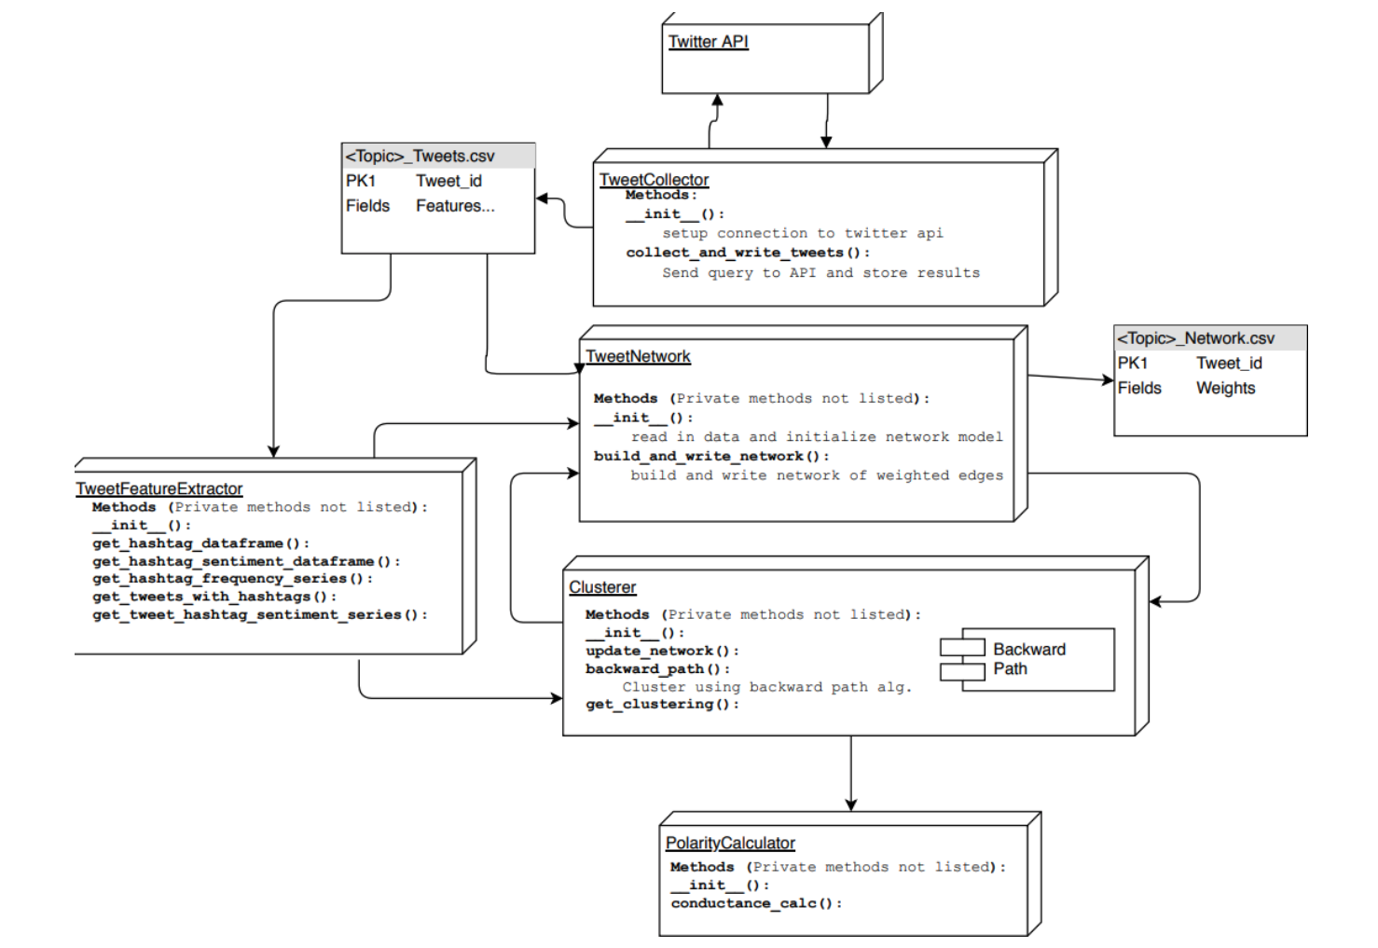
Implementation

Slide 9
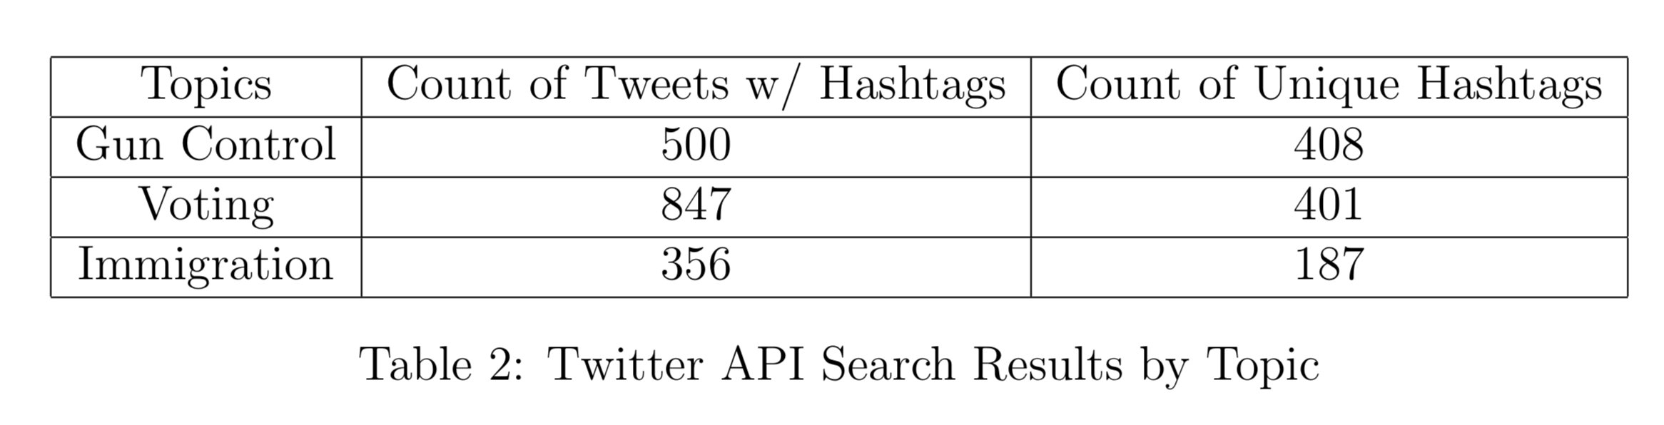
Results

Slide 10
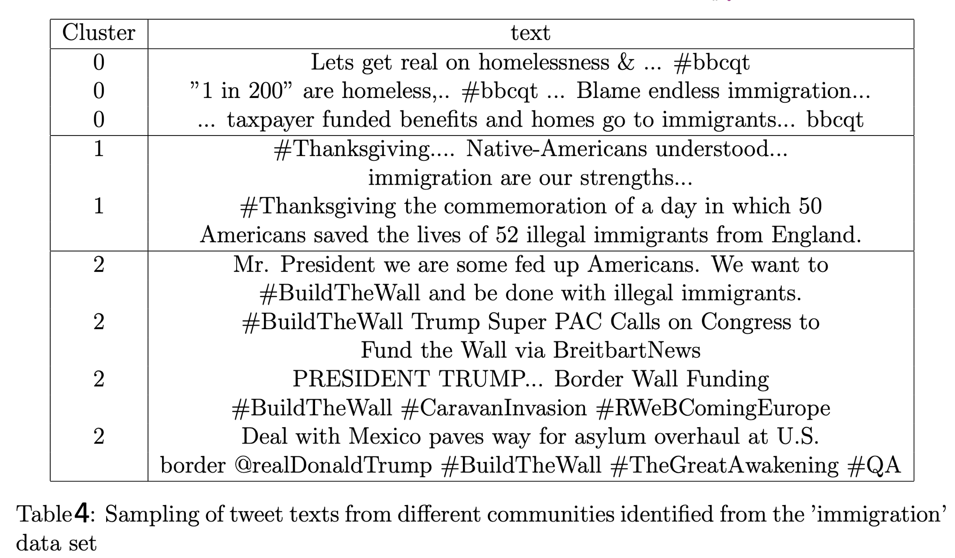
Results

Slide 11
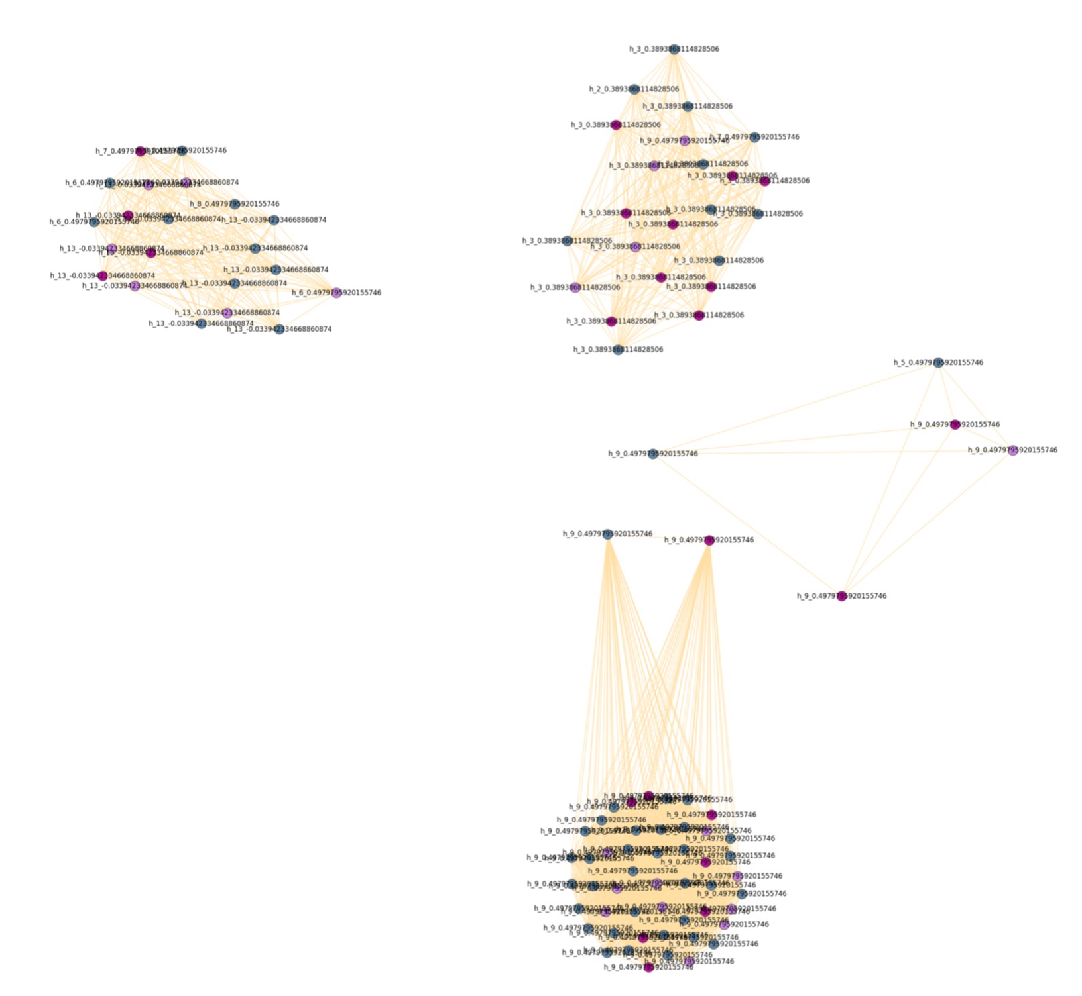
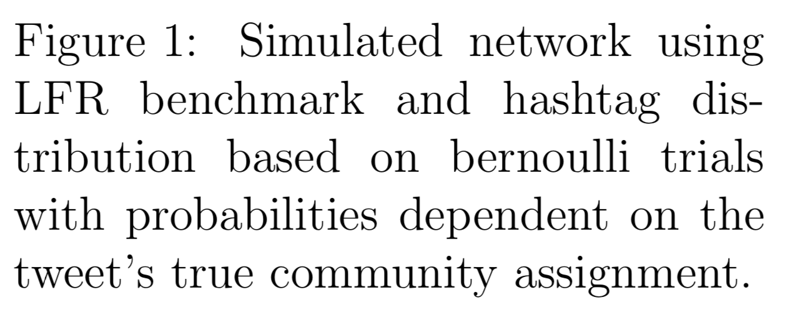
Results
Network model visualizations generated using Fruchterman-Reingold force-directed algorithm

Slide 12
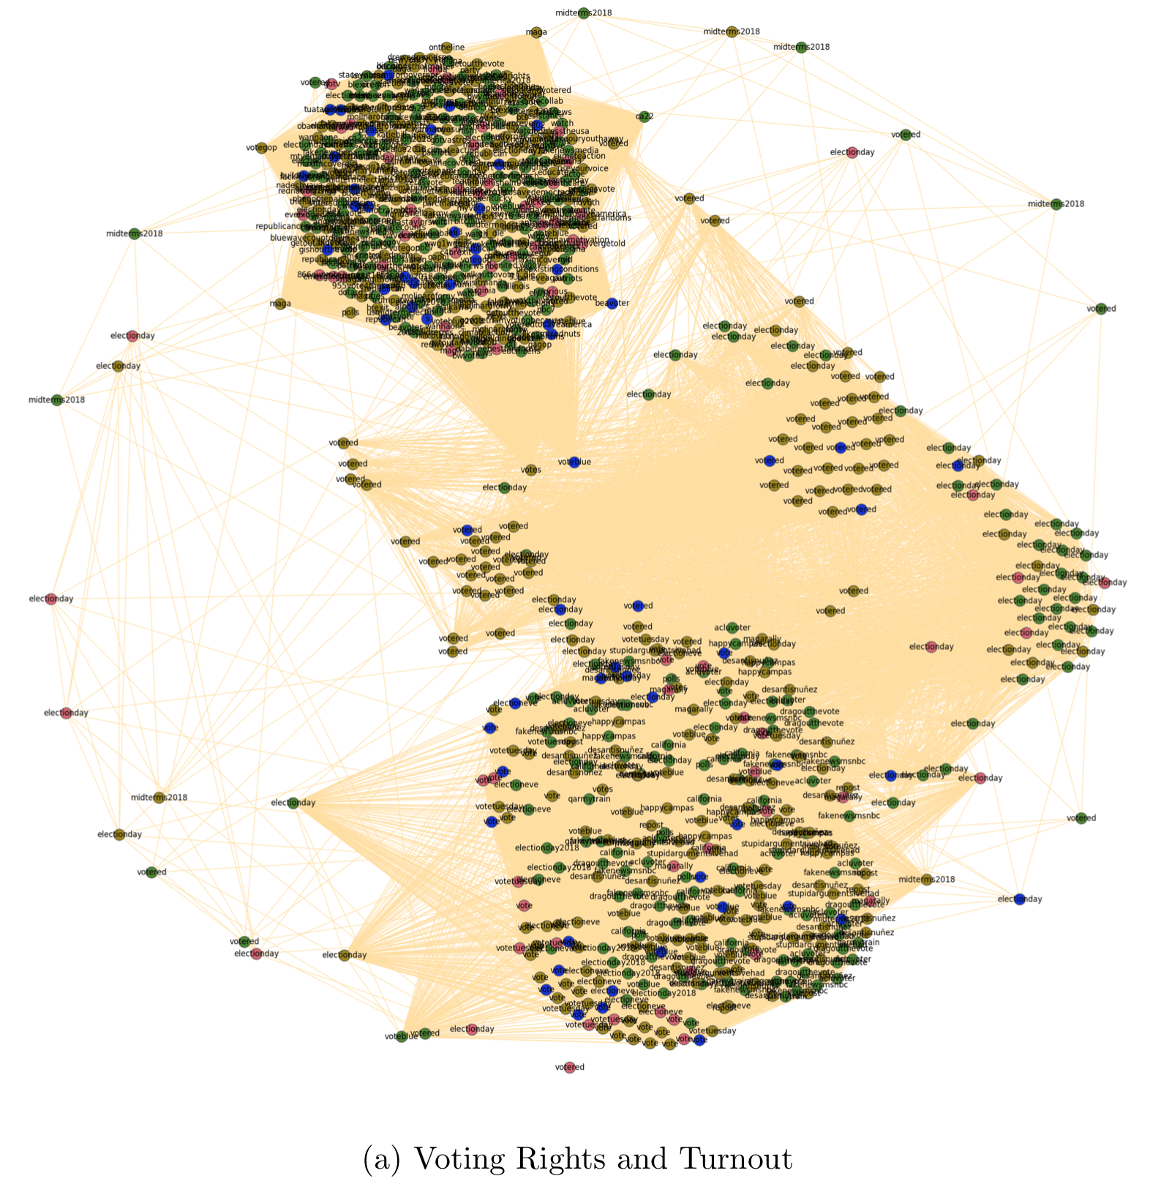
Results
Network model visualizations generated using Fruchterman-Reingold force-directed algorithm

Slide 13
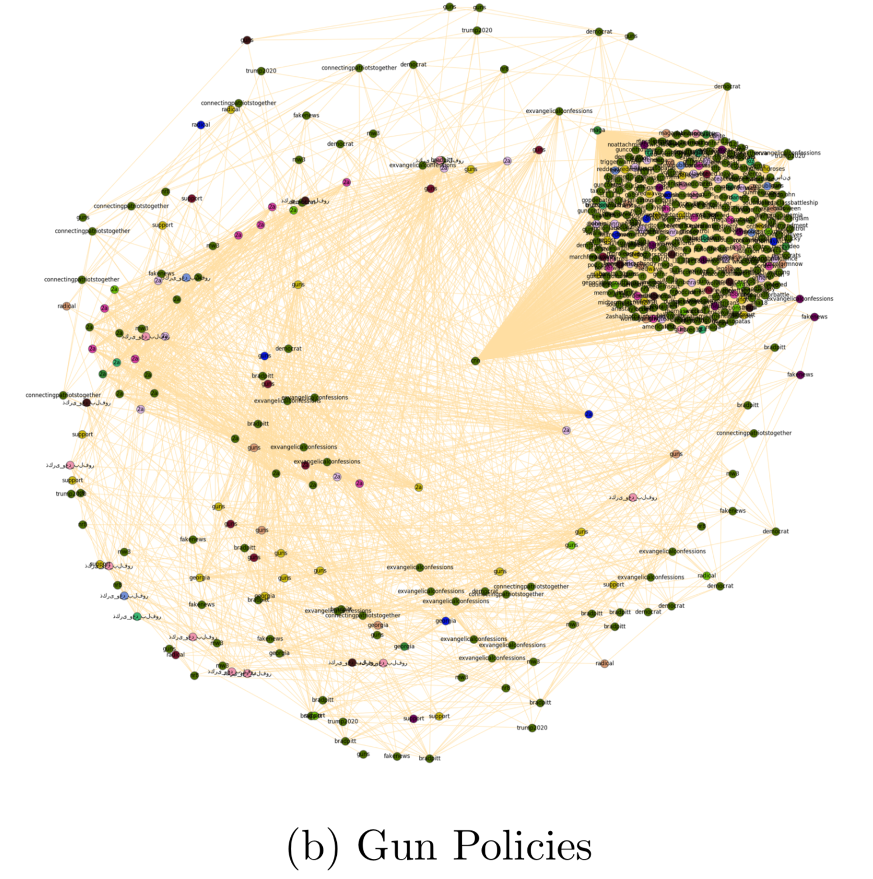
Results
Network model visualizations generated using Fruchterman-Reingold force-directed algorithm

Slide 14
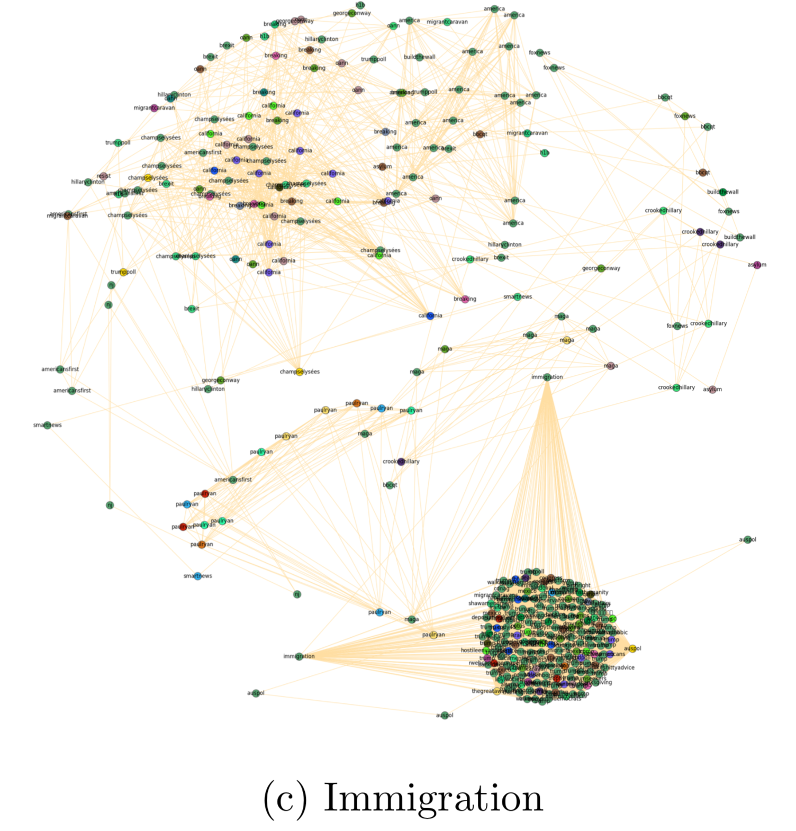
Results
Network model visualizations generated using Fruchterman-Reingold force-directed algorithm

Slide 15
Conclusions
This implementation has been a proof of concept for the techniques used to build the network model, identify communities, and measure polarity.

Slide 16
Conclusions
This implementation has been a proof of concept for the techniques used to build the network model, identify communities, and measure polarity.
The system will be developed in future work to consider additional features such as tweet popularity, tweet text sentiment, and more.

Slide 17

Acknowledgements

Slide 18
References
TED (2016). Political Polarization Illustration. [image] Available at: https://tedideas.files.wordpress.com/2016/11/featured_art.jpg?w=750 [Accessed 4 Dec. 2018].
Wired (2018). Twitter-FeatureArt. [image] Available at: https://media.wired.com/photos/5941a9186600f013e9634520/191:100/pass/Twitter-FeatureArt.jpg [Accessed 5 Dec. 2018].

